Slide 1

Dining Venues by City
Coursera Capstone project

Slide 2
Problem description & importance
Food is an important part of traveling
Travel is a significant $1.6 trillion industry
When planning a trip, tourists want to know what to expect in terms of dining venues

Slide 3
objectives
cluster major cities by food venue types
Return a map of clustered cities
Return a table of top food venue types by city

Slide 4
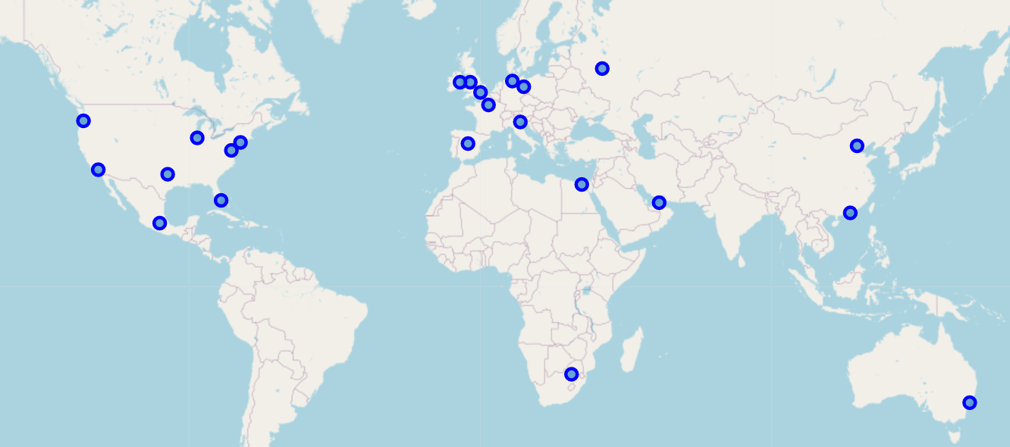
Initial un-clustered cities

Slide 5
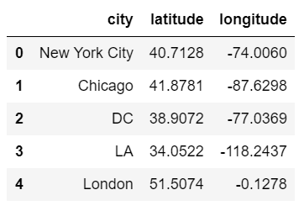
Initial data sample
Table of all 22 cities with coordinates

Slide 6
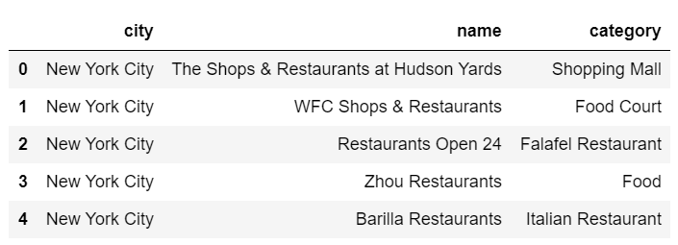
Initial data sample
Table of restaurants and categories in all 22 cities

Slide 7
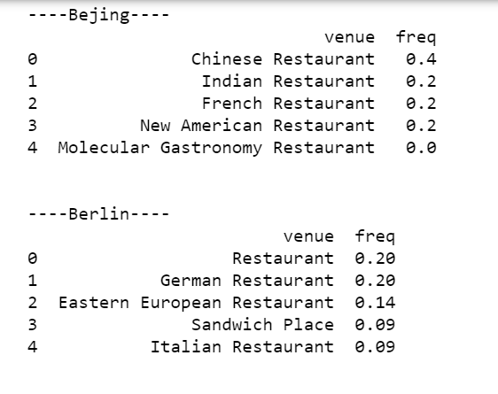
Data transformation –pre clustering this image shows a sample of output that includes the top 5 most common venues and frequency for each city. This is used for clustering

Slide 8
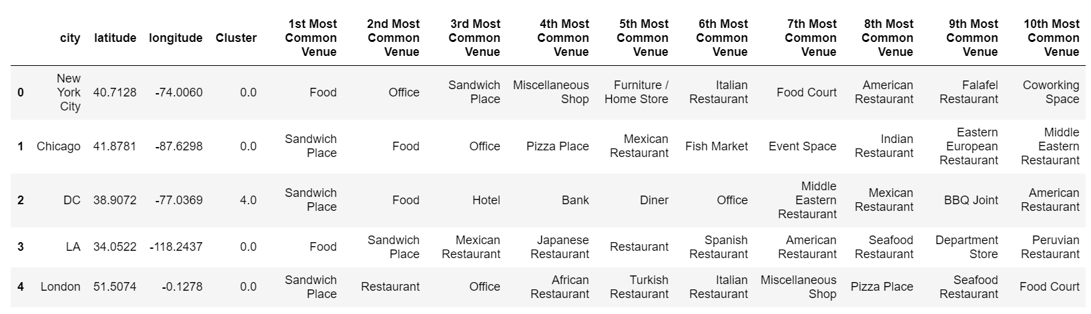
Results table

Slide 9
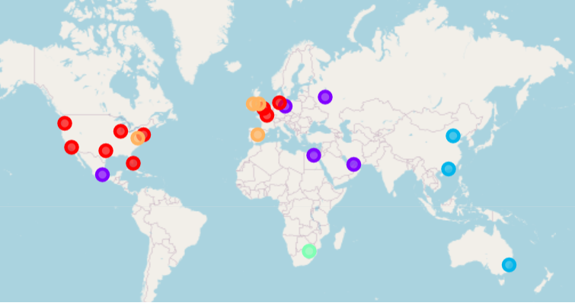
Clustered cities map

Slide 10
Results
Cities within a similar region had similar types of dining
The united states compares with western Europe
Johannesburg did not compare with any other city
Sydney, Australia compares with cities in Asia

